Slide 1
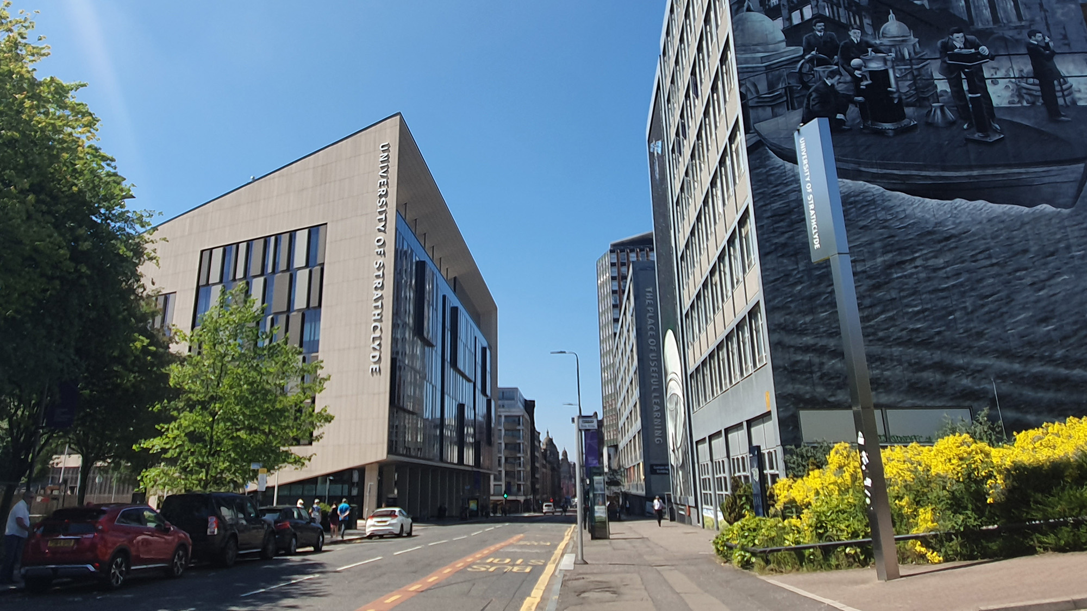

Transform Tools with Applications
Discrete Fourier Transform
carmine.clemente@strath.ac.uk

Slide 2
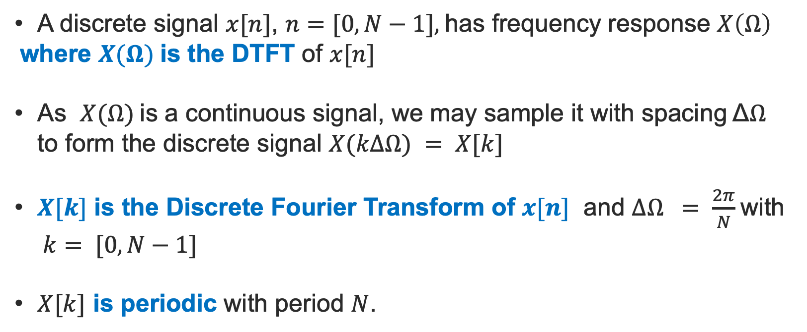
DTFT, DFT, DFS Relationship
A discrete signal $x[n]$, $n=[0, N−1],$has frequency response $X\left(Ω\right)$
where $X(Ω)$is the DTFT of $x[n]$
As $X(Ω)$is a continuous signal, we may sample it with spacing Δ$Ω$ to form the discrete signal $X(kΔΩ) = X[k]$
$X[k]$ is the Discrete Fourier Transform of $x[n]$ and $ΔΩ = \frac{2π}{N}$with $k= [0,N−1]$
$X[k]$ is periodic with period $N$.

Slide 3
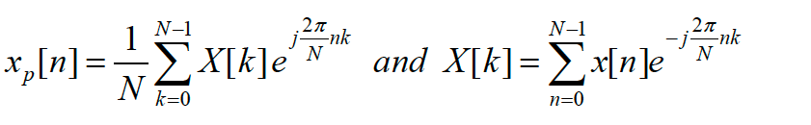
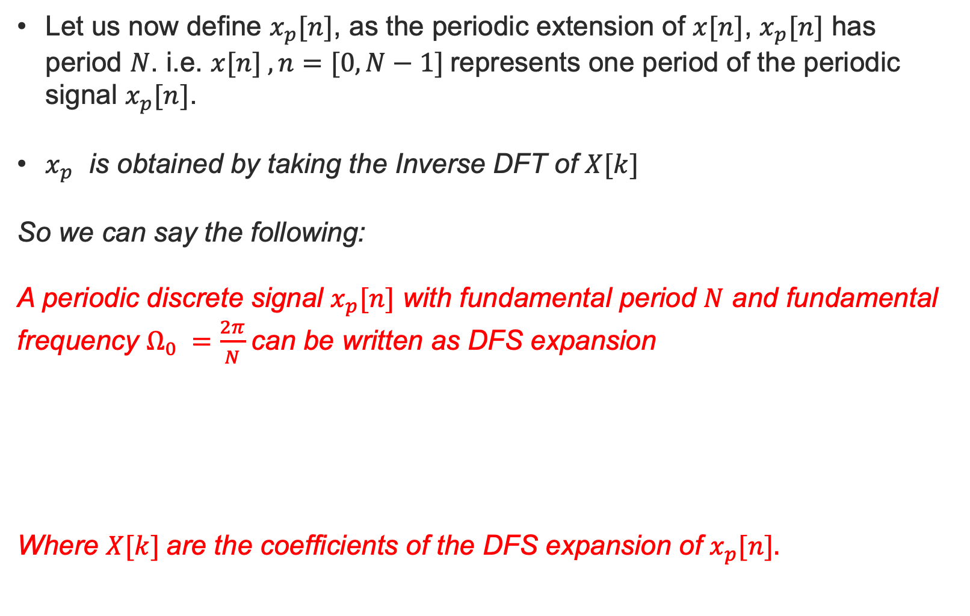
DTFT, DFT, DFS Relationship
Let us now define $x_{p}[n]$, as the periodic extension of $x[n]$, $x_{p}[n]$ has period $N$. i.e. $x[n] , n=[0,N−1]$represents one period of the periodic signal $x_{p}[n]$.
$x_{p}$ is obtained by taking the Inverse DFT of $X[k]$
So we can say the following:
A periodic discrete signal $x_{p}[n]$ with fundamental period $N$ and fundamental frequency $Ω_{0} =\frac{2π}{N}$can be written as DFS expansion
Where $X[k]$are the coefficients of the DFS expansion of $x_{p}[n].$

Slide 4
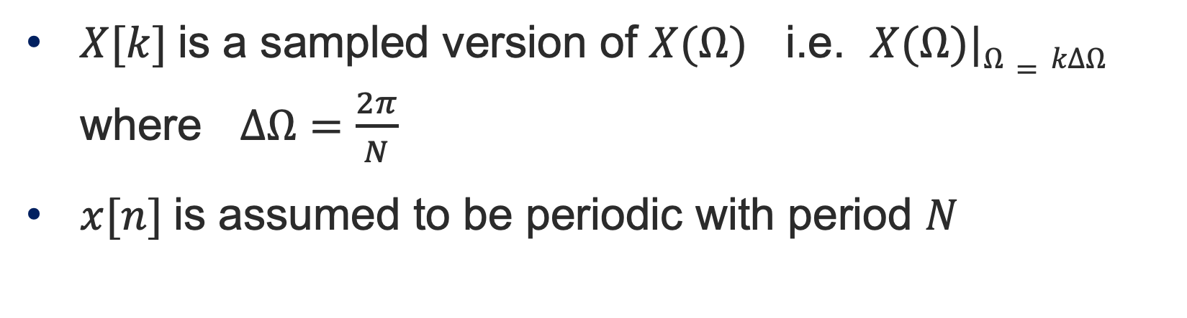
The Discrete Fourier Transform(DFT)
$X[k]$is a sampled version of $X(Ω)$ i.e. $X(Ω)|Ω=kΔΩ$ where $∆Ω=\frac{2π}{N}$
$x[n]$is assumed to be periodic with period $N$

Slide 5
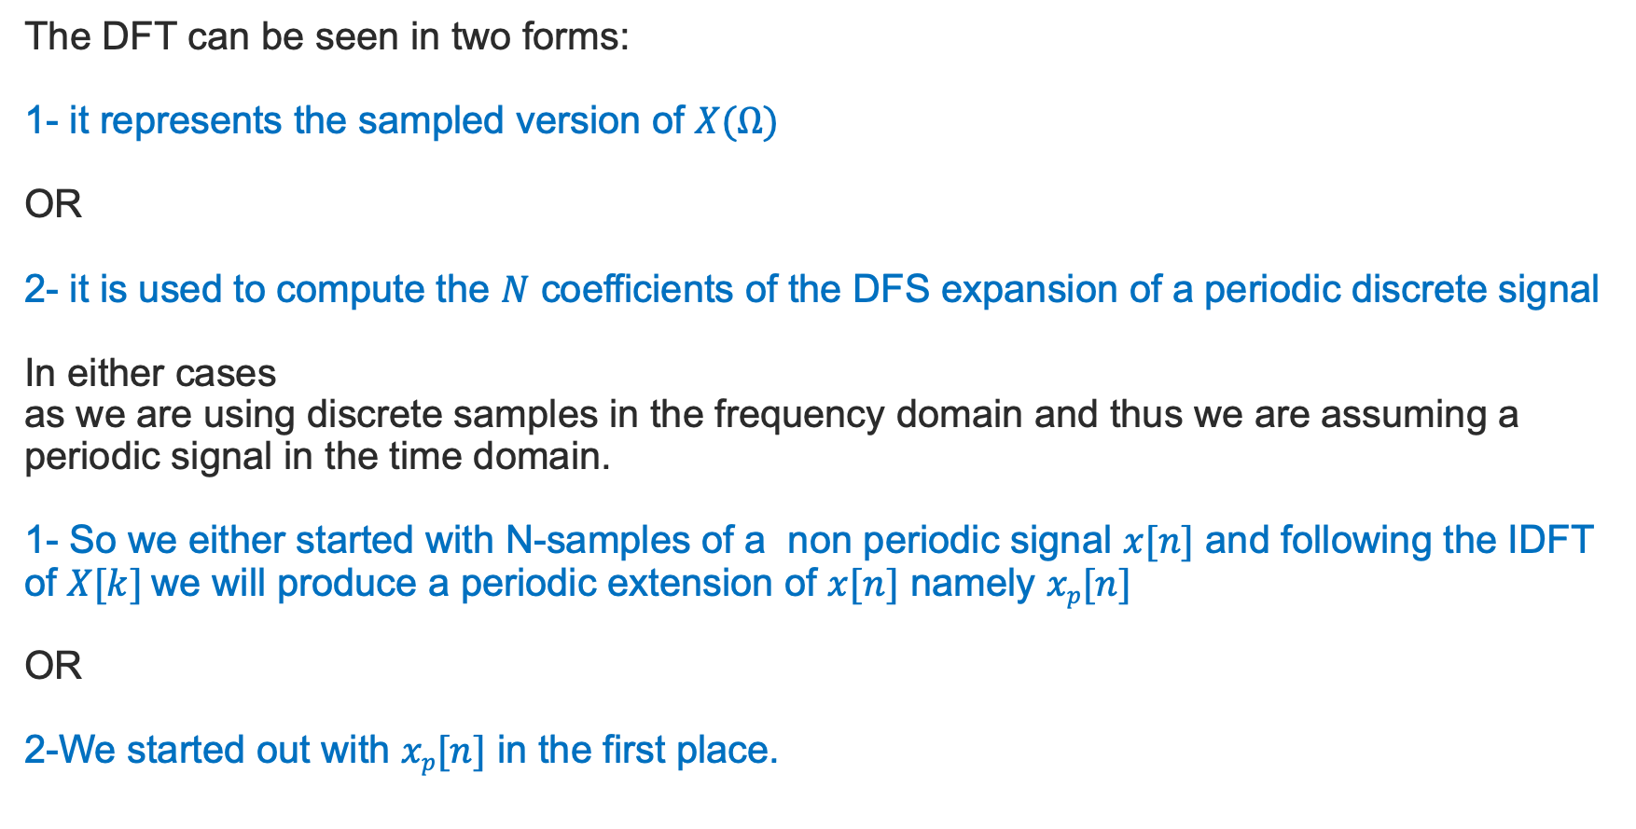
The Discrete Fourier Transform(DFT)
The DFT can be seen in two forms:
1- it represents the sampled version of $X(Ω)$
OR
2- it is used to compute the $N$ coefficients of the DFS expansion of a periodic discrete signal
In either cases
as we are using discrete samples in the frequency domain and thus we are assuming a periodic signal in the time domain.
1- So we either started with N-samples of a non periodic signal $x[n]$ and following the IDFT of $X[k]$we will produce a periodic extension of $x[n]$ namely $xp[n]$
OR
2-We started out with $xp[n]$ in the first place.

Slide 6
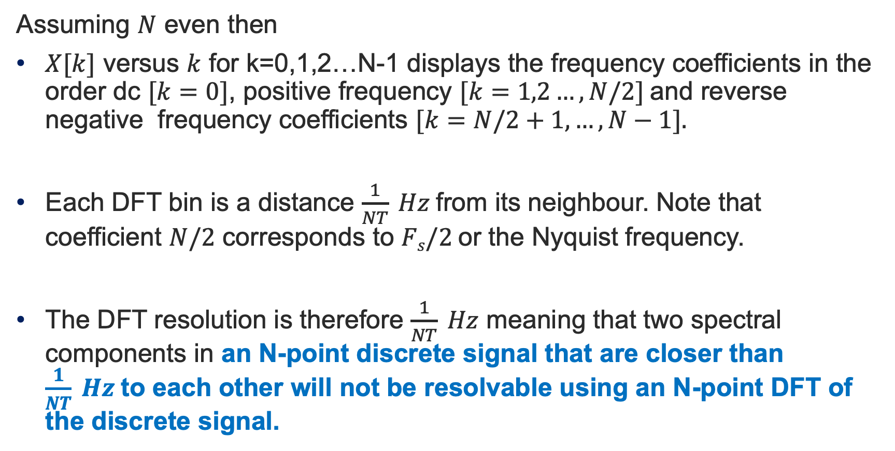
DFT Bins and Spectral Resolution
Assuming $N$ even then
$X[k]$ versus $k$ for k=0,1,2…N-1 displays the frequency coefficients in the order dc $[k=0]$, positive frequency $[k=1,2…,N/2]$and reverse negative frequency coefficients $[k=N/2+1,…,N−1].$
Each DFT bin is a distance $\frac{1}{NT} Hz$from its neighbour. Note that coefficient $N/2$ corresponds to $Fs/2$or the Nyquist frequency.
The DFT resolution is therefore $\frac{1}{NT} Hz$ meaning that two spectral components in an N-point discrete signal that are closer than $\frac{1}{NT} Hz$to each other will not be resolvable using an N-point DFT of the discrete signal.

Slide 7
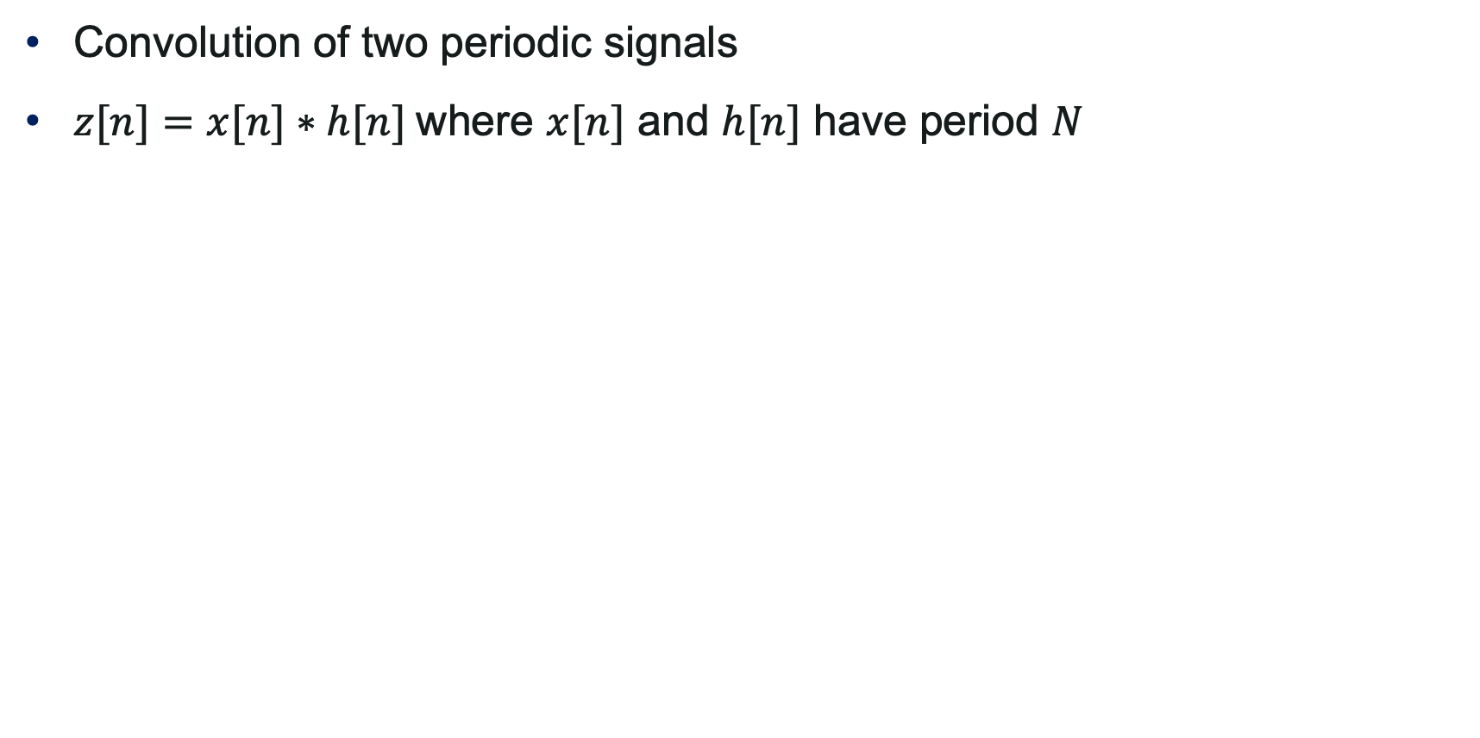
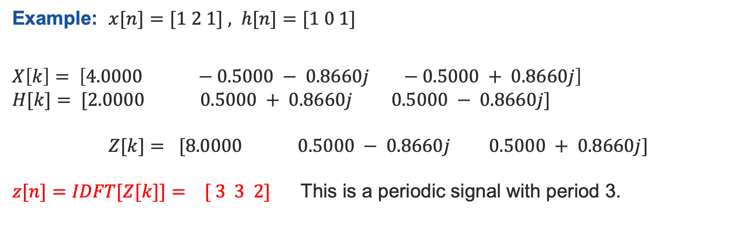
DFT For Convolution
Convolution of two periodic signals
$z[n]=x[n]∗h[n]$where $x[n]$ and $h[n]$ have period $N$
Example: $x[n]=[1 2 1] , h[n]=[1 0 1]$
$$X\left[k\right]= \left[4.0000 −0.5000 − 0.8660j −0.5000 + 0.8660j\right]$$
$$H[k]= [2.0000 0.5000 + 0.8660j 0.5000 − 0.8660j]$$
$$Z[k]= [8.0000 0.5000 − 0.8660j 0.5000 + 0.8660j]$$
$z[n]=IDFT[Z[k]]= [ 3 3 2]$This is a periodic signal with period 3.

Slide 8
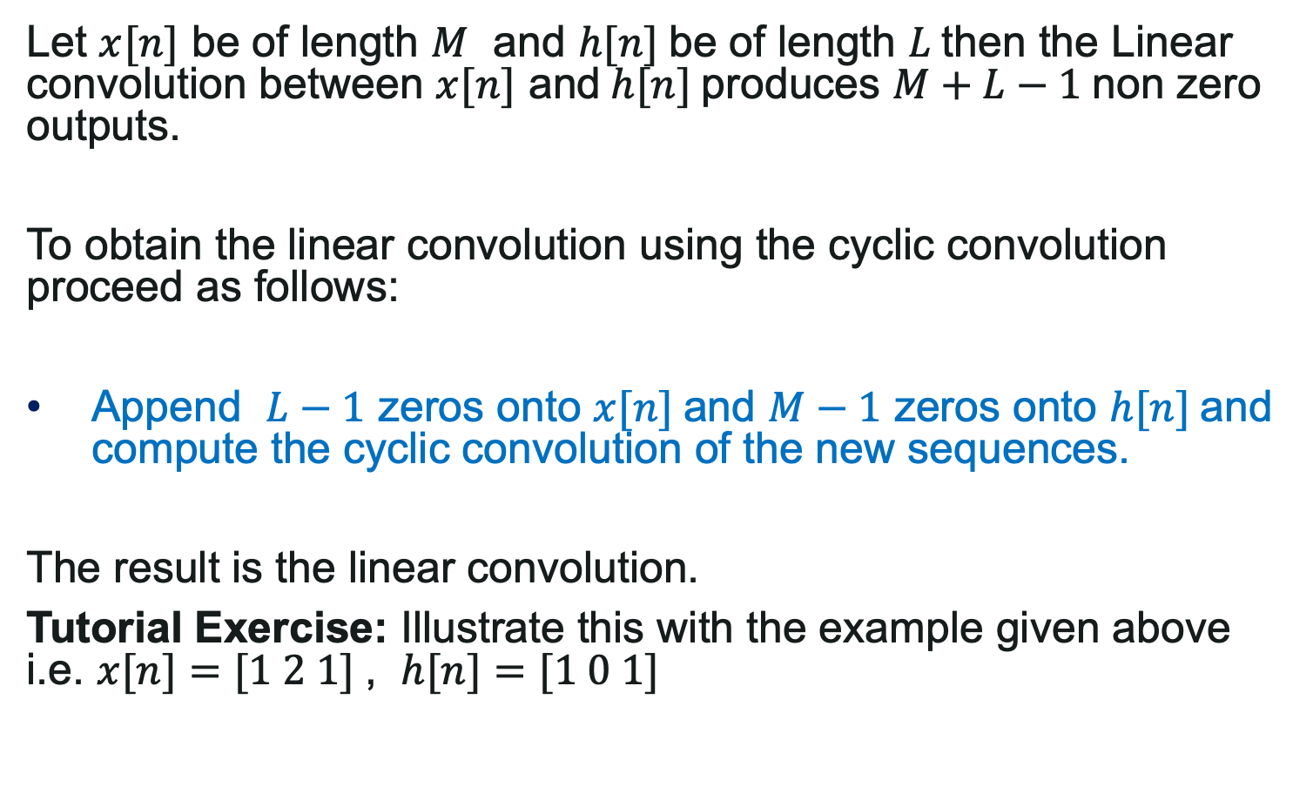
Linear/Cyclic Convolution/Correlation
Let $x[n]$ be of length $M$ and $h[n]$be of length $L$then the Linear convolution between $x[n]$ and$h[n]$produces $M+L−1$non zero outputs.
To obtain the linear convolution using the cyclic convolution proceed as follows:
Append $L−1$ zeros onto $x[n]$and $M−1$ zeros onto $h[n]$and compute the cyclic convolution of the new sequences.
The result is the linear convolution.
Tutorial Exercise: Illustrate this with the example given above i.e. $x[n]=[1 2 1]$, $h[n]=[1 0 1]$

Slide 9
Spectral Leakage and Scallop Loss
Two important DFT characteristics that are now investigated namely Spectral Leakage and Scallop Loss (SL).
Spectral leakage occurs due to the fact that, for some sinusoidal components of a signal, a non-integer number of periods of this sinusoid will be acquired. Windowing using window functions are used to reduce the effects of Scallop Loss and Spectral Leakage.
Scallop Loss is the loss in energy observed due to the fact that the some or all of the frequency components of the signal do not coincide with exact DFT bins.

Slide 10
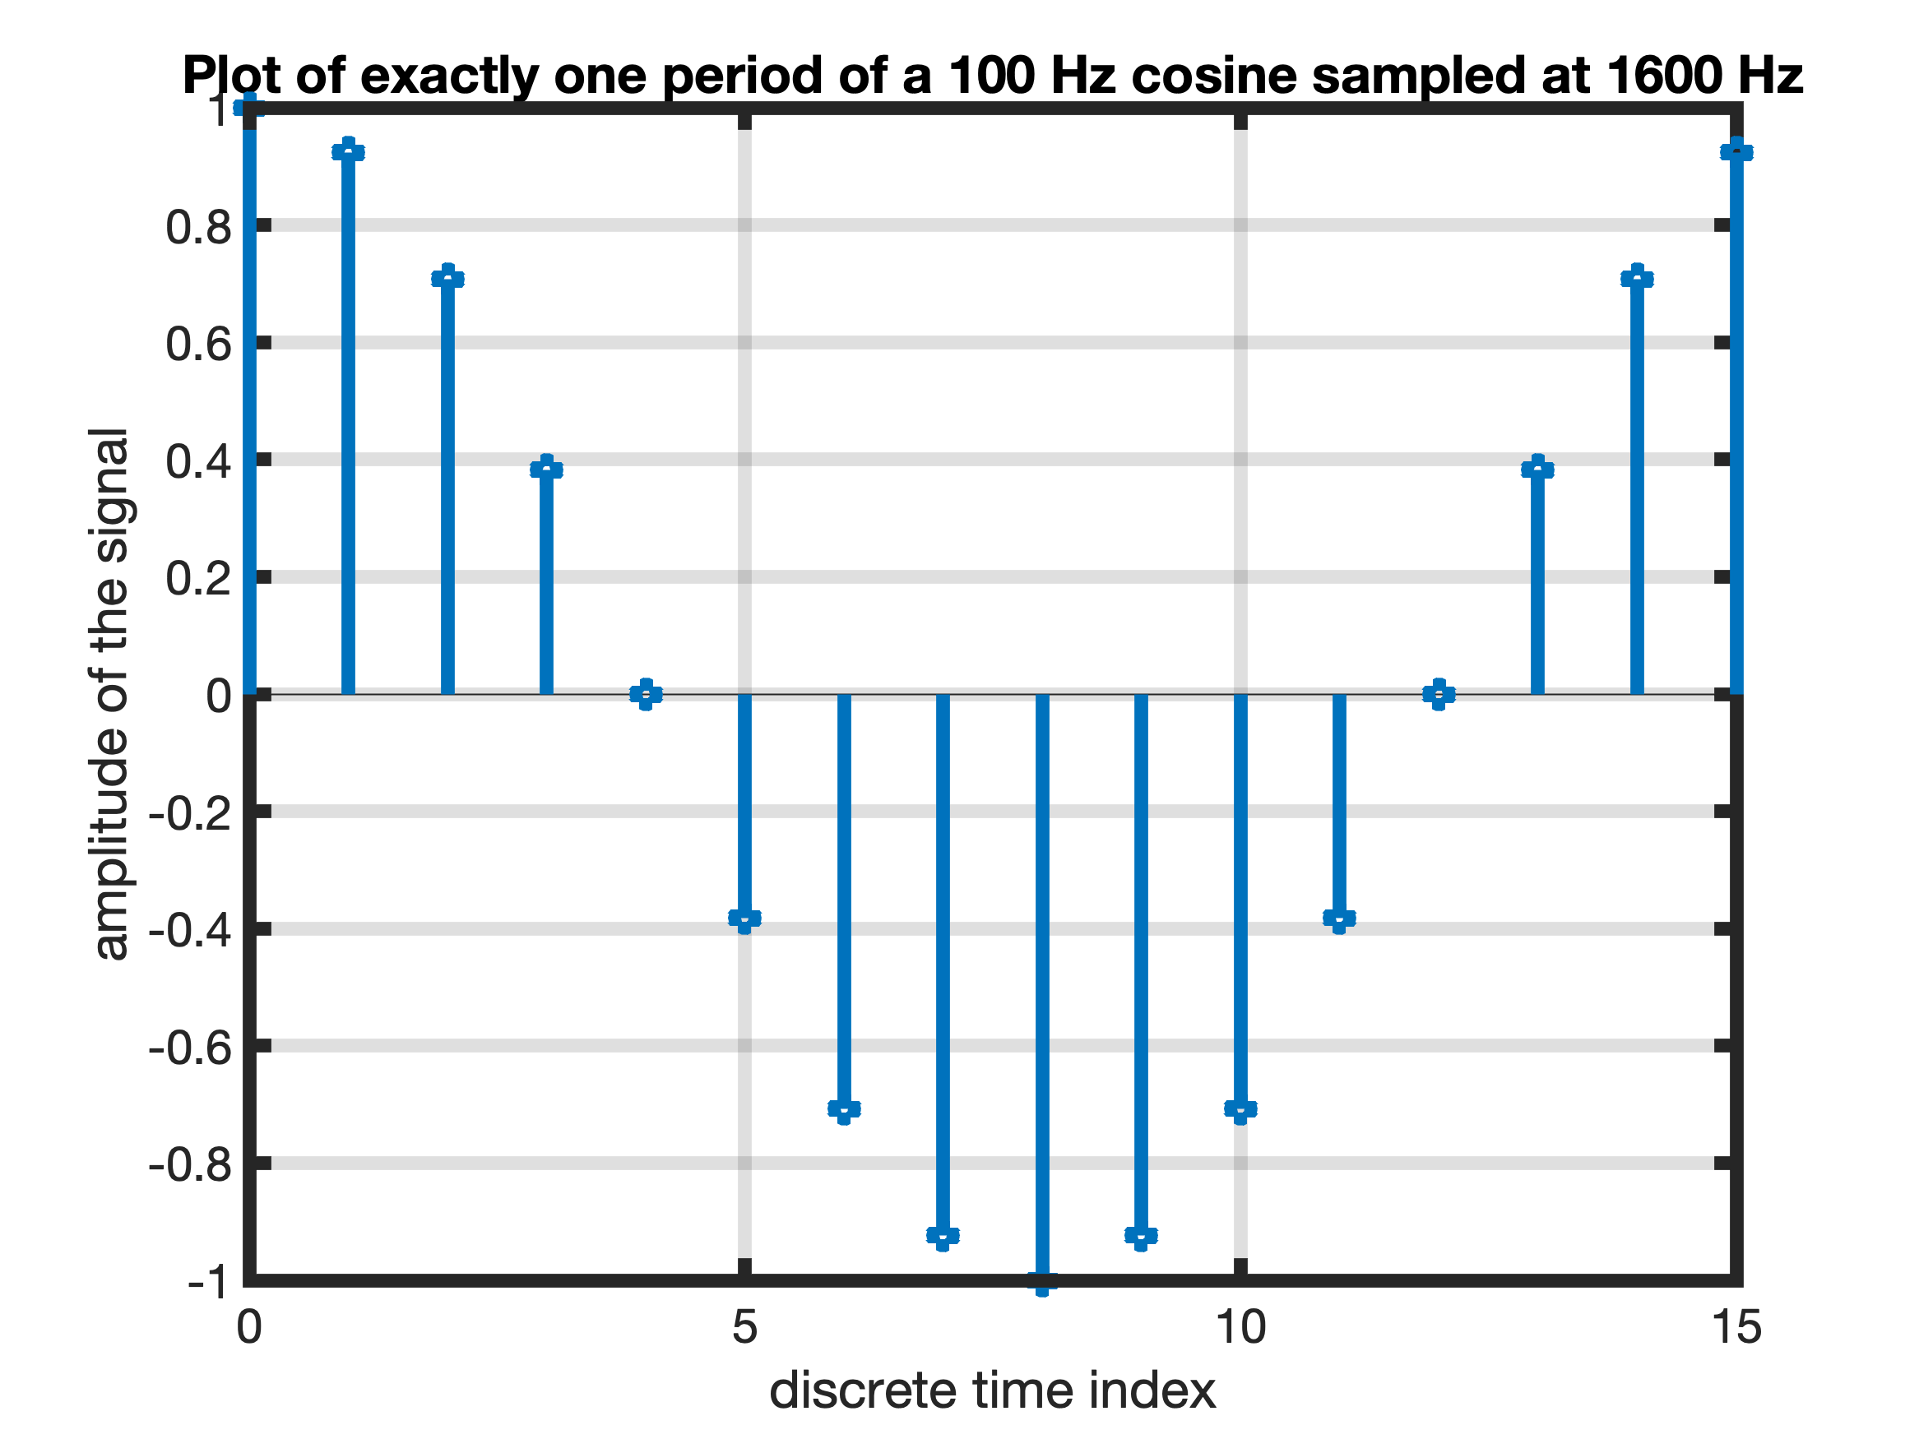
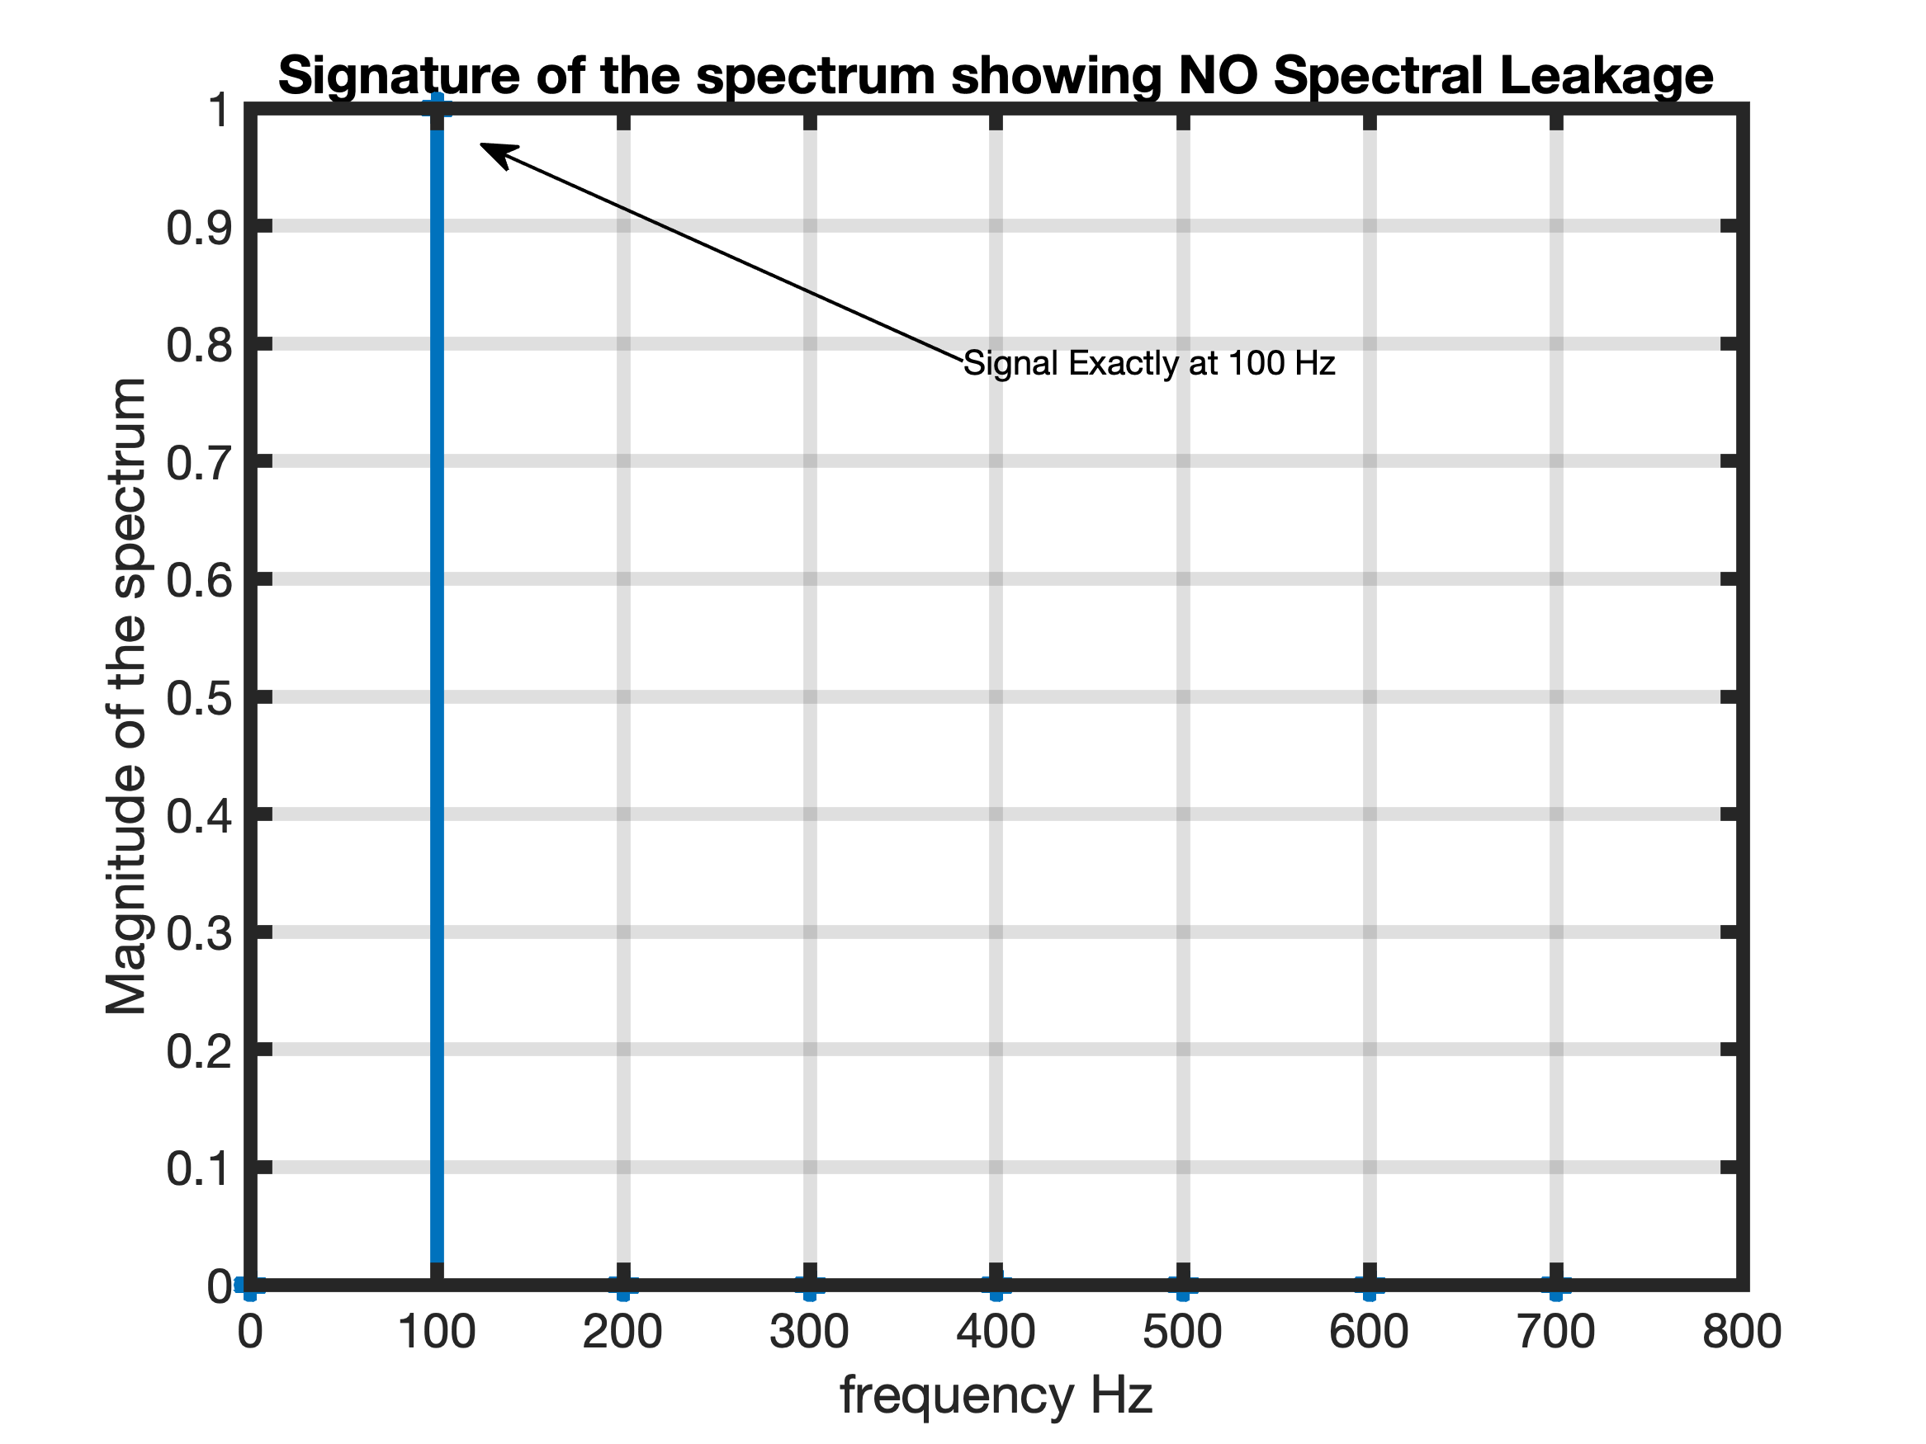
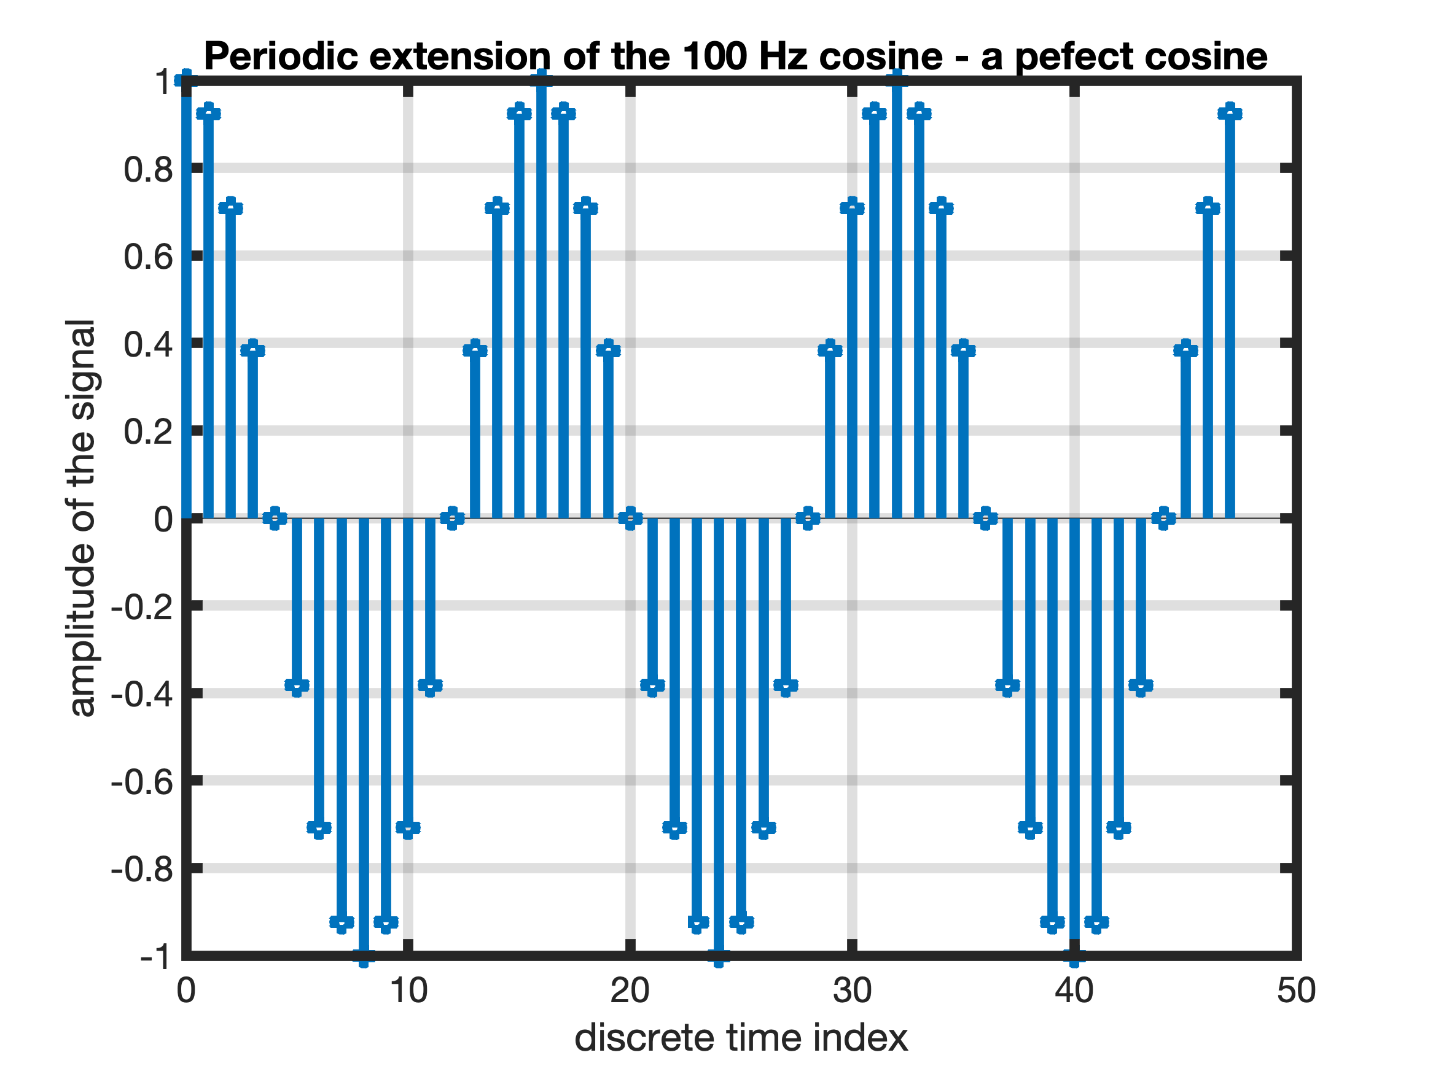
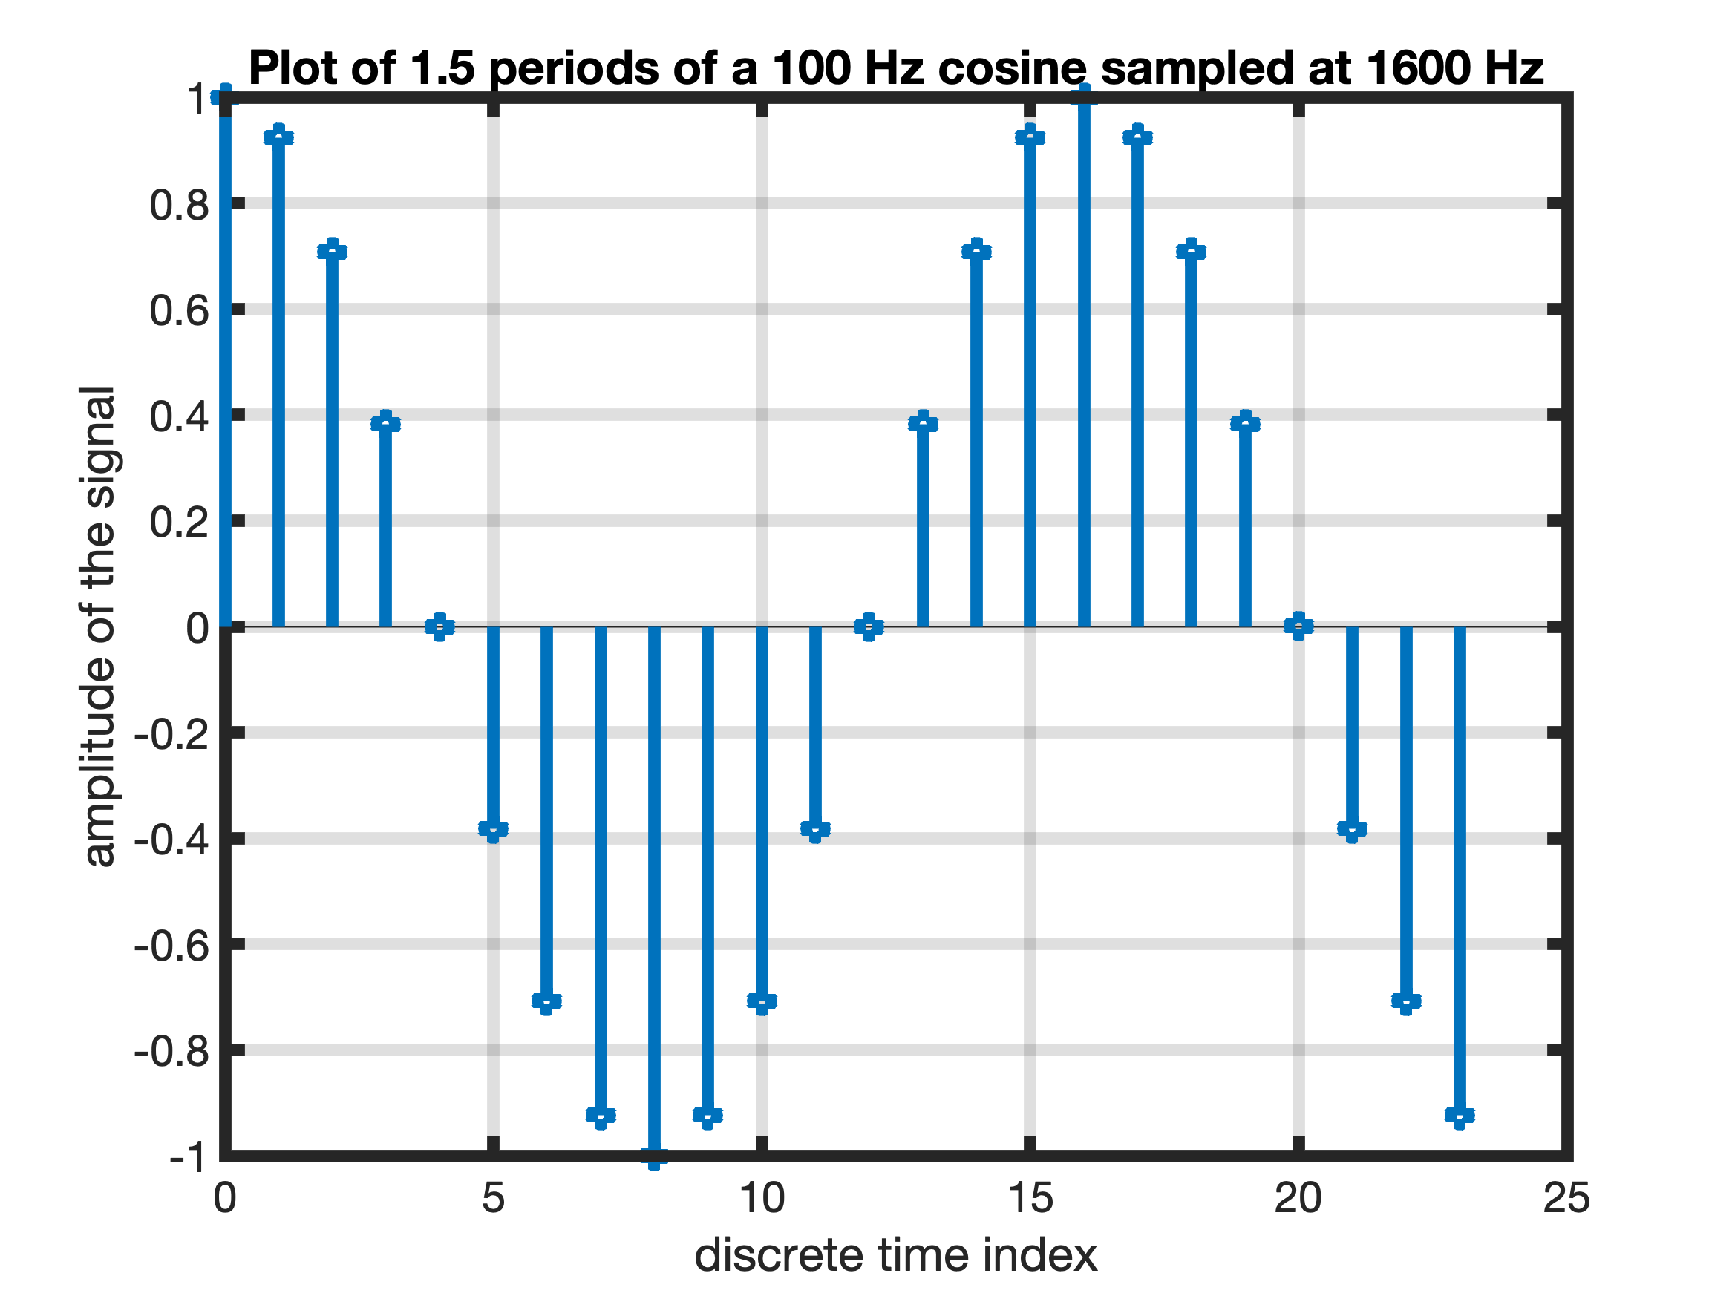
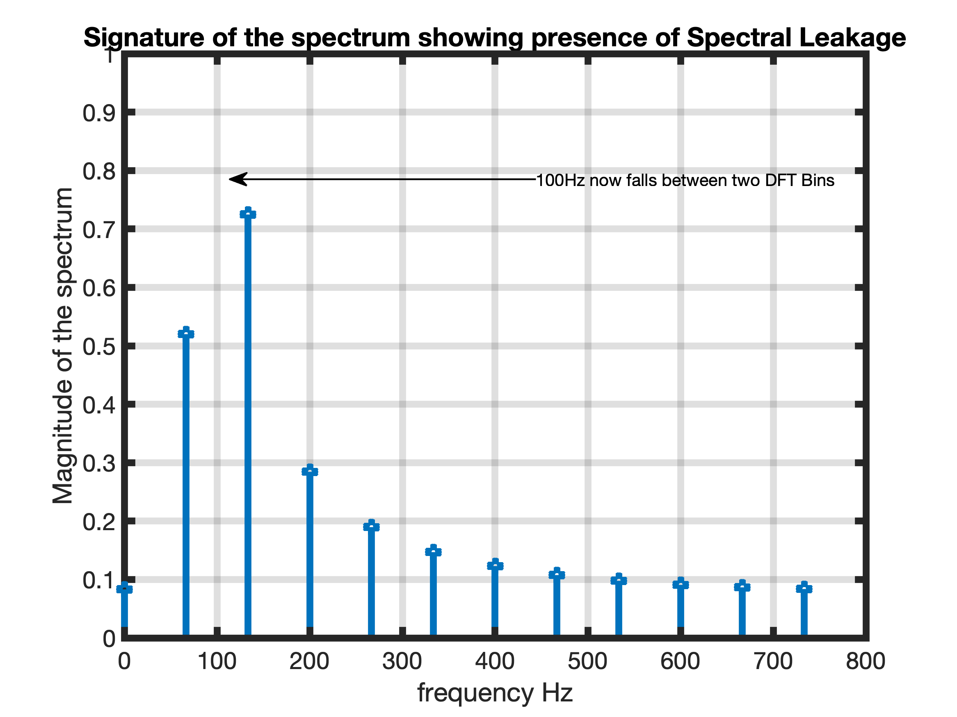
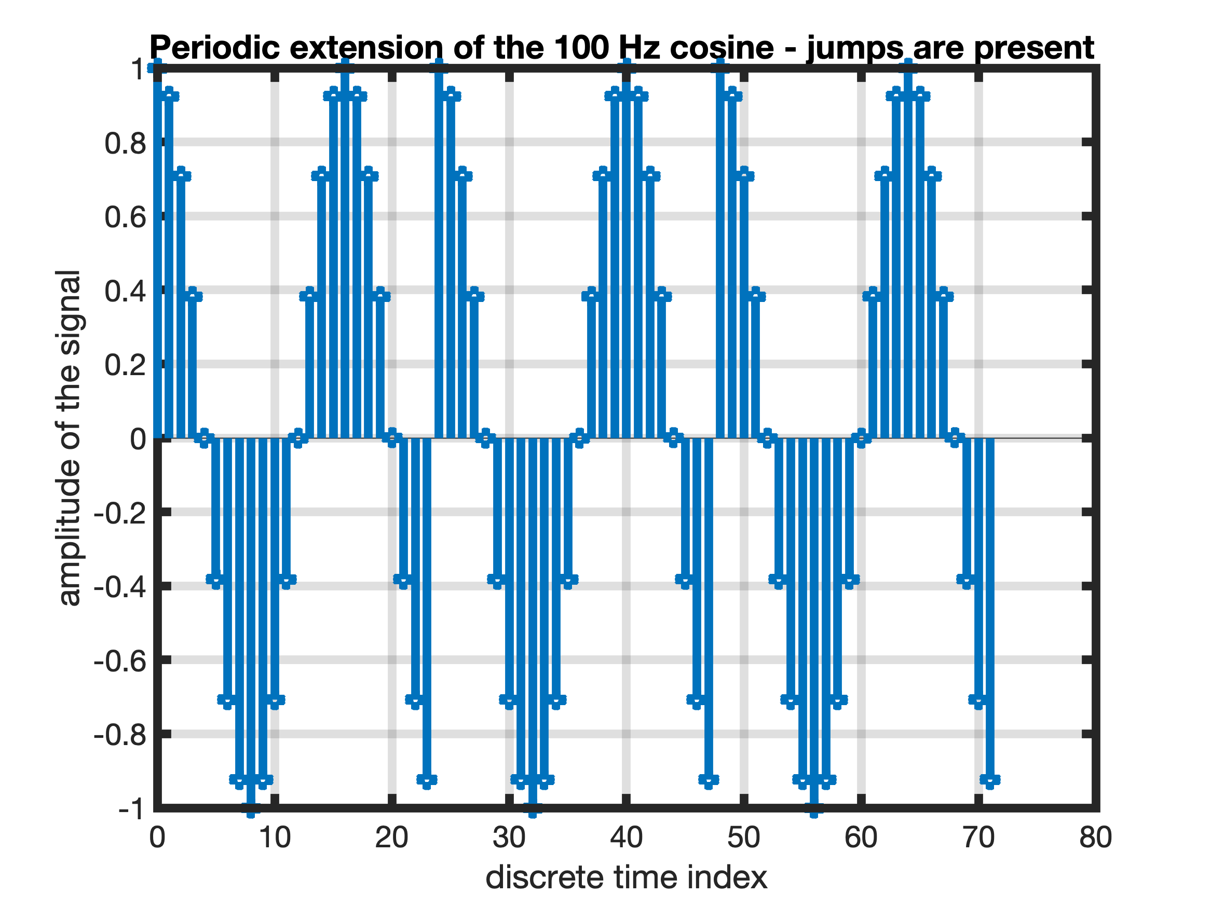
Spectral Leakage and Scallop Loss
The spectrum us spreading – Leaking into other frequency components
The magnitude is reduced – Scallop Loss

Slide 11
Windows
Windowing using window functions are used to reduce the effects of Scallop Loss and Spectral Leakage.
First let us define 5 popular windows of length N.
Each window has its own characteristics in terms of Side-lobe levels and main-lobe size.
Rectangular
Hanning
Hamming
Blackman
Kaiser

Slide 12
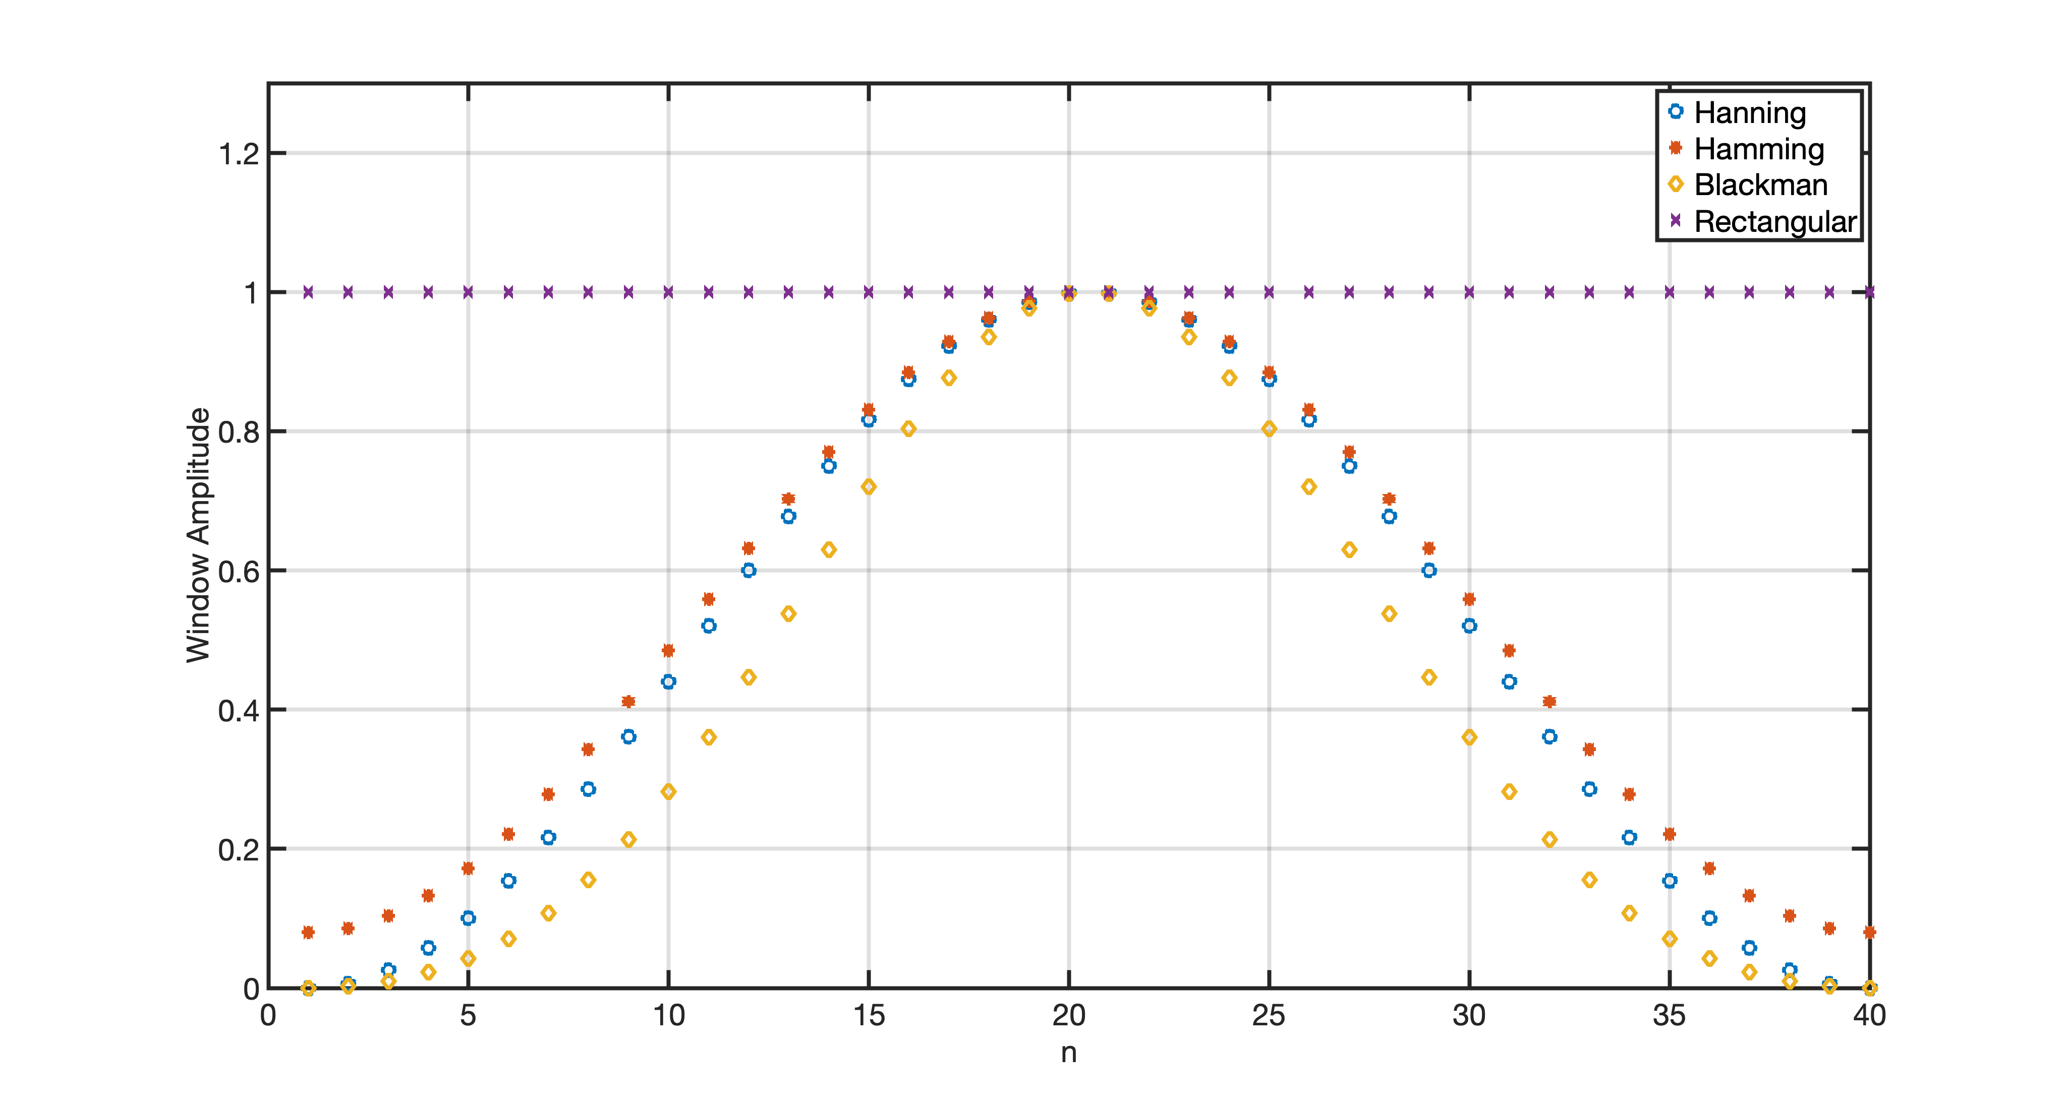
Windows
Time plot – N=40

Slide 13
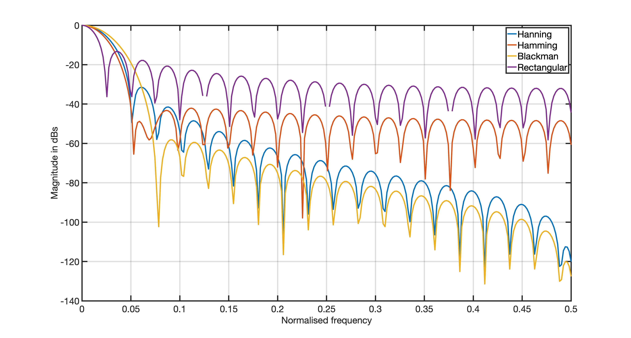
Windows- Spectra
Lower side lobes mitigate spectral leakage… but the main lobe broadens!

Slide 14
Scallop Loss
DFT Bins viewed as main lobes of various BPFs
0 1 2 3 4 5
k, DFT Bins
Scallop Loss
Main lobe response for each DFT bin
Max response
Min response
0 1 2 3 4 5

Slide 15
Quantifying the Scallop Loss
Independently of the window type, it is possible to quantify the amount of Scallop Loss for each window

Slide 16
Windows- Characteristics
Window | 1st Side Lobe level(dBs) | SL dBs
Rectangular | -13 | 3.92
Hanning | -31 | 1.42
Hamming | -41 | 1.78
Blackman | -57 | 1.10
Kaiser b=2 | -19 | 1.46
Kaiser b=4 | -30 | 1.46
Kaiser b=6 | -44 | 1.46
Kaiser b = 10 | -59 | 1.46
Kaiser b=12 | -74 | 1.46

Slide 17
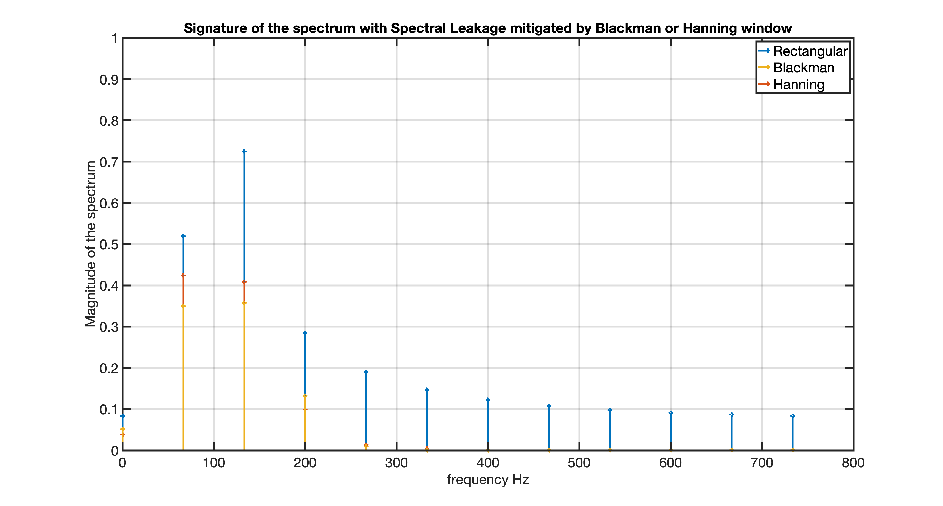
Windows –Spectral Leakage Mitigation
Now the 100 Hz falls in the middle of the DFT bin
Spectral leakage mitigated

Slide 18

Evaluating the DFT – (i) DFT Matrix Method
The DFT can be written in matrix form, lets’ start to see how to create the DFT Matrix
$W_{N}$is periodic with period $N$ and we will exploit it!
In general

Slide 19
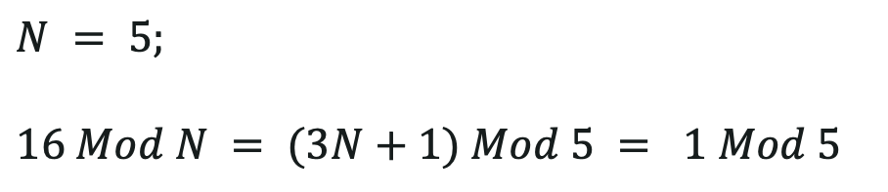
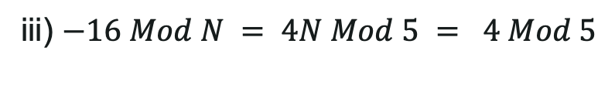

Evaluating the DFT – (i) DFT Matrix Method
Examples:
i)
$$N = 5;$$
$$16 Mod N = (3N+1) Mod 5 = 1 Mod 5$$
ii)
$$(5N+6) Mod N = 6 Mod N$$
General rule: you need to add as many Ns until you reach a number between 0 and N-1.
iii) $−16 Mod N = 4N Mod 5 = 4 Mod 5$

Slide 20
Evaluating the DFT – (i) DFT Matrix Method
The DFT can be written in matrix form

Slide 21
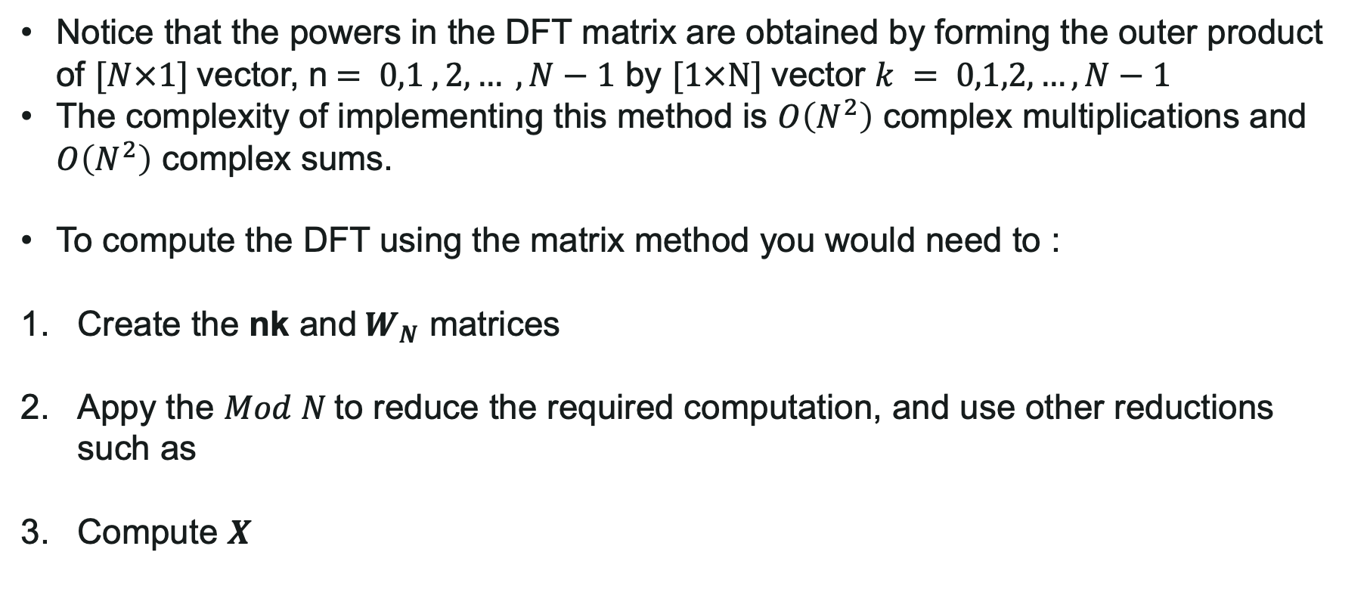
Evaluating the DFT – (i) DFT Matrix Method
Notice that the powers in the DFT matrix are obtained by forming the outer product of $[N×1]$vector, n$= 0,1 ,2,… , N−1$ by $[1×N]$vector $k = 0,1,2,…, N−1$
The complexity of implementing this method is $O\left(N^{2}\right)$ complex multiplications and $O\left(N^{2}\right)$ complex sums.
To compute the DFT using the matrix method you would need to :
Create the nk and${ W}_{N}$ matrices
Appy the $Mod N$to reduce the required computation, and use other reductions such as
Compute $X$

Slide 22
Evaluating the DFT – (i) DFT Matrix Method
Example
N =4;
nk matrix
(matrix of nk products)
n
n = 0,1,2,3; k = 0,1,2,3;
k
0 1 2 3
0
1
2
3
0 0 0 0
0 1 2 3
0 2 4 6
0 3 6 9

Slide 23
Evaluating the DFT – (i) DFT Matrix Method
Example - continued
nk matrix
(matrix of nk products)
n
k
0 1 2 3
0
1
2
3
0 0 0 0
0 1 2 3
0 2 4 6
0 3 6 9
0 0 0 0
0 1 2 3
0 2 0 2
0 3 2 1
Mod 4
=

Slide 24
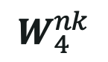
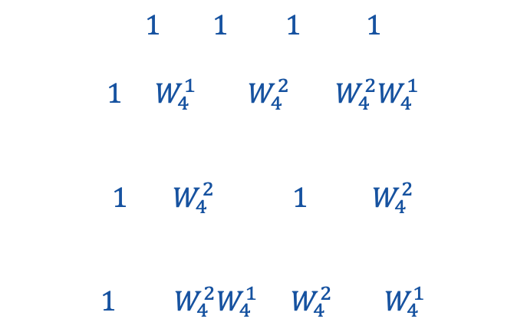
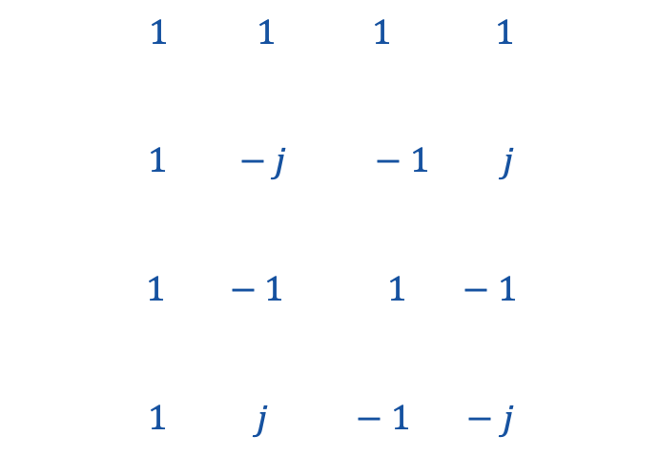
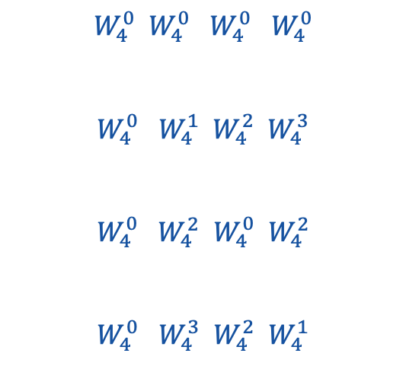
Evaluating the DFT – (i) DFT Matrix Method
DFT MATRIX FOR N=4
Example - continued
$$W_{4}^{0} W_{4}^{0} W_{4}^{0} W_{4}^{0}$$
$$W_{4}^{0} W_{4}^{1} W_{4}^{2} W_{4}^{3}$$
$$W_{4}^{0} W_{4}^{2} W_{4}^{0} W_{4}^{2}$$
$$W_{4}^{0} W_{4}^{3} W_{4}^{2} W_{4}^{1}$$
$$1 1 1 1$$
$$1 { W}_{4}^{1} W_{4}^{2} W_{4}^{2}W_{4}^{1}$$
$$1 W_{4}^{2} 1 W_{4}^{2}$$
$$1 { W}_{4}^{2}W_{4}^{1} W_{4}^{2} W_{4}^{1}$$
$$1 1 1 1$$
$1 −j −1 j$
$$1 −1 1 −1$$
$1 j −1 −j$
$$W_{4}^{nk}$$
=
=
=
Does not require multiplications!

Slide 25
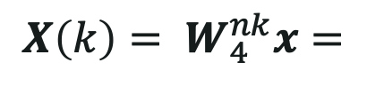
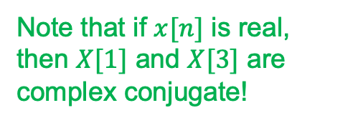
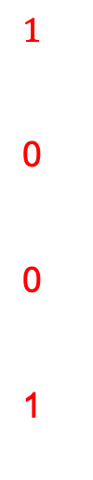
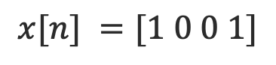
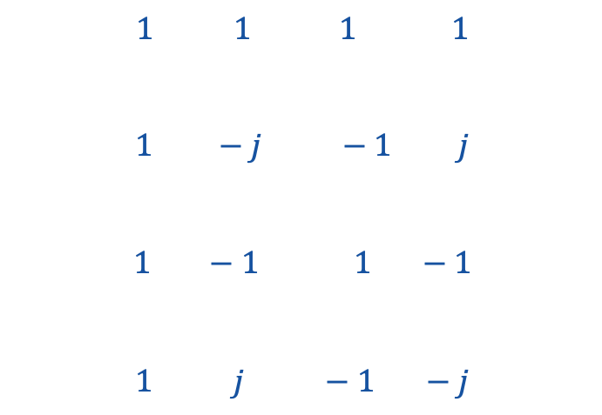
Evaluating the DFT – (i) DFT Matrix Method
Example - continued
$$x[n] =[1 0 0 1]$$
$$1 1 1 1$$
$1 −j −1 j$
$$1 −1 1 −1$$
$1 j −1 −j$
$$1$$
0
0
1
2
1+j
0
1-j
Note that if $x[n]$ is real, then $X[1]$ and $X[3]$ are complex conjugate!
$${X\left(k\right)= W}_{4}^{nk}x=$$
=

Slide 26
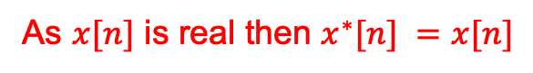
Evaluating the DFT – (i) DFT Matrix Method
Let us now consider the IDFT for our example
If we consider the complex conjugate instead:
As $x[n]$ is real then $x^{∗}[n] =x[n]$
So we can compute the IDFT by using the same DFT matrix used to compute the DFT!

Slide 27
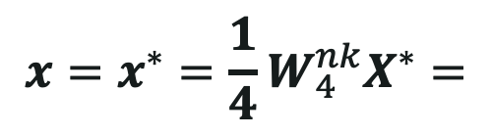
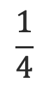

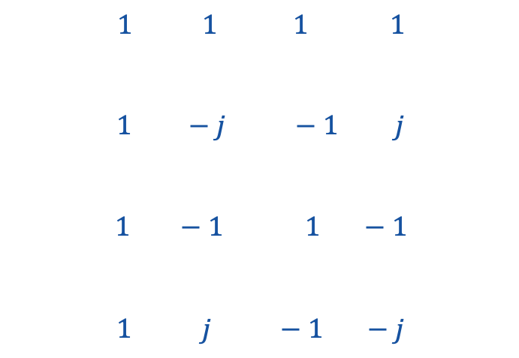
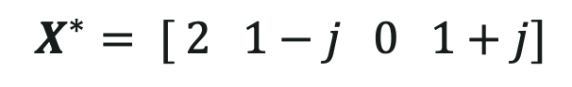
Evaluating the DFT – (i) DFT Matrix Method
IDFT Example
$$X^{∗}= [ 2 1−j 0 1+j]$$
2
1-j
0
1+j
$$1$$
0
0
1
$$1 1 1 1$$
$1 −j −1 j$
$$1 −1 1 −1$$
$1 j −1 −j$
$${x=x^{∗}=\frac{1}{4}W}_{4}^{nk}X^{∗}=$$
$$\frac{1}{4}$$
=

Slide 28
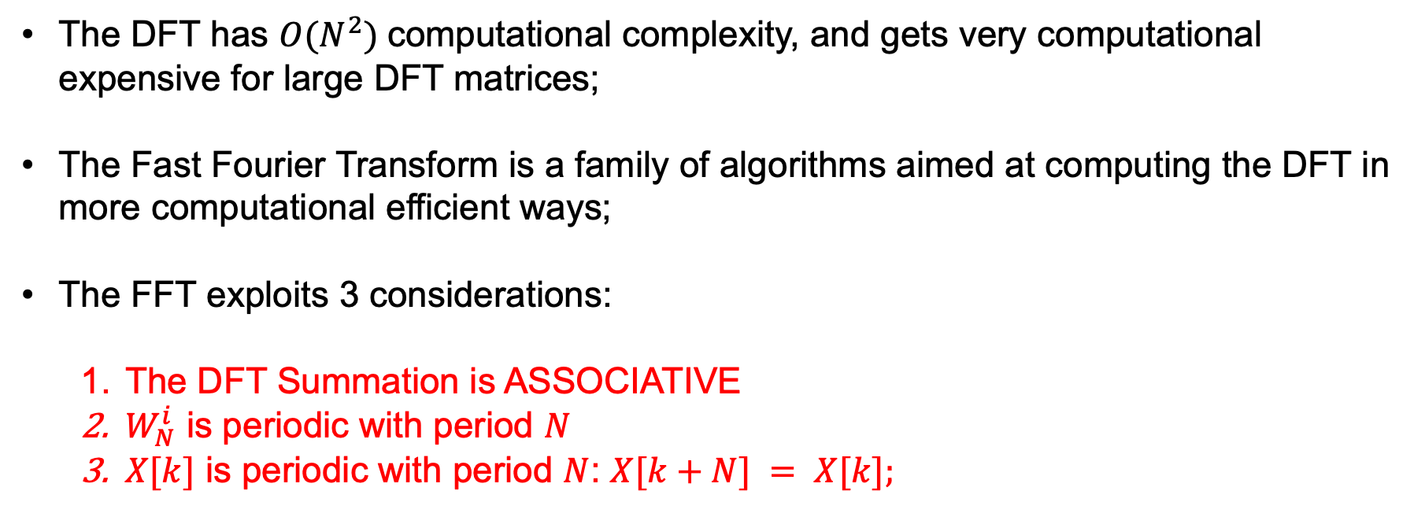
Evaluating the DFT – (ii) FFT
The DFT has $O(N^{2})$computational complexity, and gets very computational expensive for large DFT matrices;
The Fast Fourier Transform is a family of algorithms aimed at computing the DFT in more computational efficient ways;
The FFT exploits 3 considerations:
The DFT Summation is ASSOCIATIVE
$W_{N}^{i}$ is periodic with period $N$
$X[k]$ is periodic with period $N$: $X[k+N] = X[k];$

Slide 29
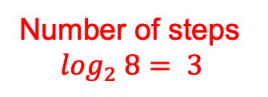
Evaluating the DFT – (ii) FFT
Problem: We want to compute the sum of the integers between 1 and 8:
Solution 1
Solution 2
Serial
Divide and Conquer approach
The FFT is doing the same type of approach to compute the DFT
Step 1 – 4 sums in parallel
x = 1;
for ind =2:8;
x = x+ind;
end
x1 = 1+2; x2 = 3+4; x3= 5+6; x4 =7+8;
Step 2 – 2 sums in parallel
Number of steps
$$log_{2} 8= 3$$
x11 = x1+x2; x12 = x3+x4;
Step 3 – 1 sequential sum
We have 7 consecutive sums.
x = x11+x12;
We still have 7 sums, but now I have parallelized them.

Slide 30
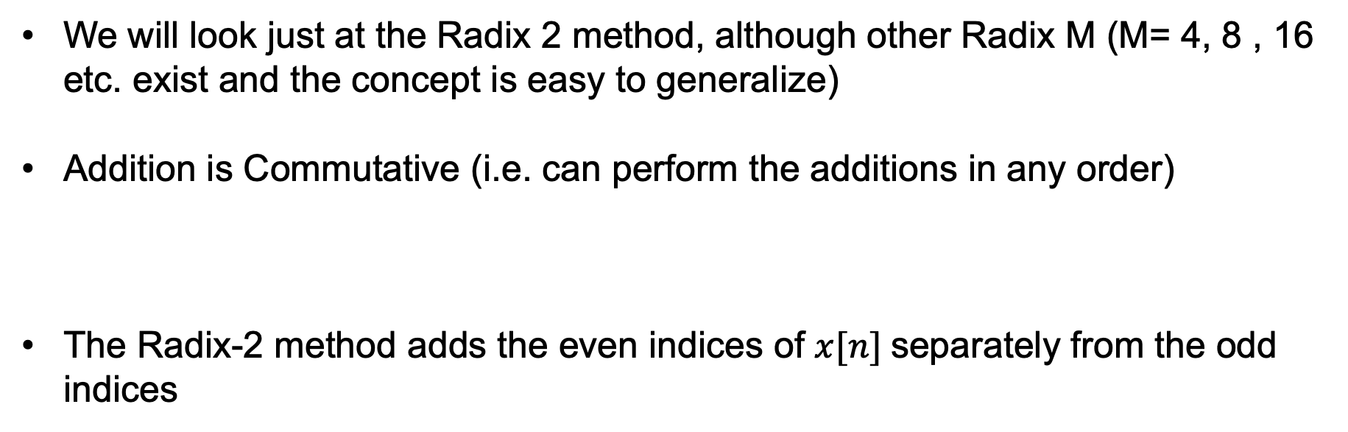
Evaluating the DFT – (ii) FFT
Radix 2 Decimation in time FFT method (Cooley–Tukey algorithm).
We will look just at the Radix 2 method, although other Radix M (M= 4, 8 , 16 etc. exist and the concept is easy to generalize)
Addition is Commutative (i.e. can perform the additions in any order)
The Radix-2 method adds the even indices of $x[n]$separately from the odd indices

Slide 31


Radix 2 Decimation in time FFT method
Even
Odd
If we observe that
We can divide both k and N by 2
Bring $W_{N}^{k}$outside
Divide both k and N by 2
These are two $\frac{N}{2}$ points DFTs!
Twiddle Factor

Slide 32
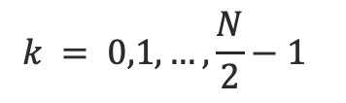
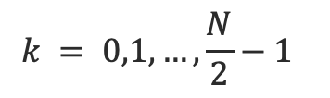
Radix 2 Decimation in time FFT method
Periodic with period N/2
1)
$$k = 0,1,…,\frac{N}{2}−1$$
These are only N/2 values! We need to find the other N/2!
We exploit the periodicity!
2)
$$k = 0,1,…,\frac{N}{2}−1$$
1) and 2) are the Decimation in Time (DiT) Butterfly FFT elements and are key to compute the FFT.

Slide 33
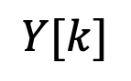
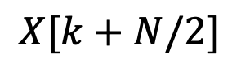
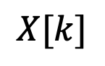

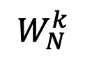
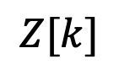
Radix 2 Decimation in time FFT method
1)
$$k = 0,1,…,\frac{N}{2}−1$$
2)
Radix 2 FFT butterfly
$$Y[k]$$
+
$$X[k]$$
$$Z[k]$$
-
+
$$X[k+N/2]$$
$$W_{N}^{k}$$

Slide 34
Radix 2 Decimation in time FFT method
Radix 2 FFT butterfly expanded
Y[0]
Y[1]
.
:
Y[N/2 – 1]
X[0]
X[1]
X[N/2 -1]
W_{N}⁰
-1
Z[0]
Z[1]
.
:
Z[N/2 – 1]
X[N/2]
W_{N}¹
-1
X[N/2 +1]
W_{N}^{N/2 -1}
-1
X[N-1]

Slide 35
Radix 2 Decimation in time FFT method
We can recursively repeat the process of the two N/2 DFTs by splitting each of them in 2 N/4 DFTs…
And we can go on until we have N one single point sequences…
Let’s see it for an example for N= 8;

Slide 36
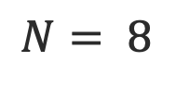
Radix 2 Decimation in time FFT method
$$N= 8$$
DECIMATION PROCESS
One 8-points sequence
Two 4-points sequences
Four 2-points sequences
Eight 1-points sequences
0
1
2
3
4
5
6
7
0
2
4
6
0
4
0
4
2
6
2
6
1
3
5
7
1
5
1
5
3
7
3
7

Slide 37
Radix 2 Decimation in time FFT method
$$N= 8$$
DECIMATION PROCESS
One 8-points sequence
Two 4-points sequences
Four 2-points sequences
Eight 1-points sequences
0
1
2
3
4
5
6
7
0
2
4
6
0
4
0
4
2
6
2
6
1
3
5
7
1
5
1
5
3
7
3
7

Slide 38
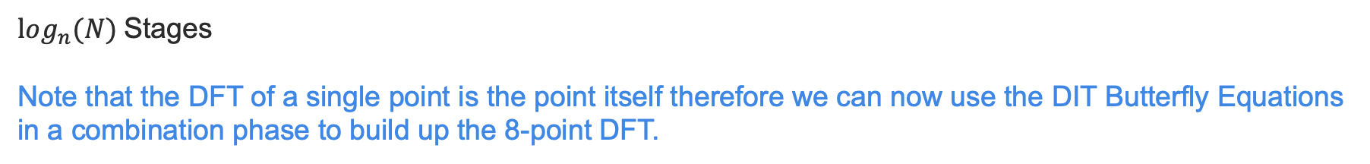
Radix 2 Decimation in time FFT method
Combination PROCESS
$log_{n}(N)$Stages
Note that the DFT of a single point is the point itself therefore we can now use the DIT Butterfly Equations in a combination phase to build up the 8-point DFT.
X[0]
0
Y[0]
Z[0]
Y[0]
Y[1]
Y[0]
Y[1]
Y[2]
Y[3]
W⁰₂
X[1]
4
2
Y[0]
Z[0]
Z[0]
Z[1]
W⁰₄
X[2]
6
W⁰₂
W¹₄
X[3]
1
Y[0]
Z[0]
Y[0]
Y[1]
Z[0]
Z[1]
Z[2]
Z[3]
W₈⁰
-1
W⁰₂
X[4]
5
W₈¹
3
Y[0]
Z[0]
W⁰₄
-1
X[5]
Z[0]
Z[1]
W₈²
7
W⁰₂
W¹₄
-1
X[6]
W₈³
-1
X[7]
Eight
1-point DFTs
Four
2-point DFTs
Two
4-point DFTs
One
8-point DFT
(as required)

Slide 39
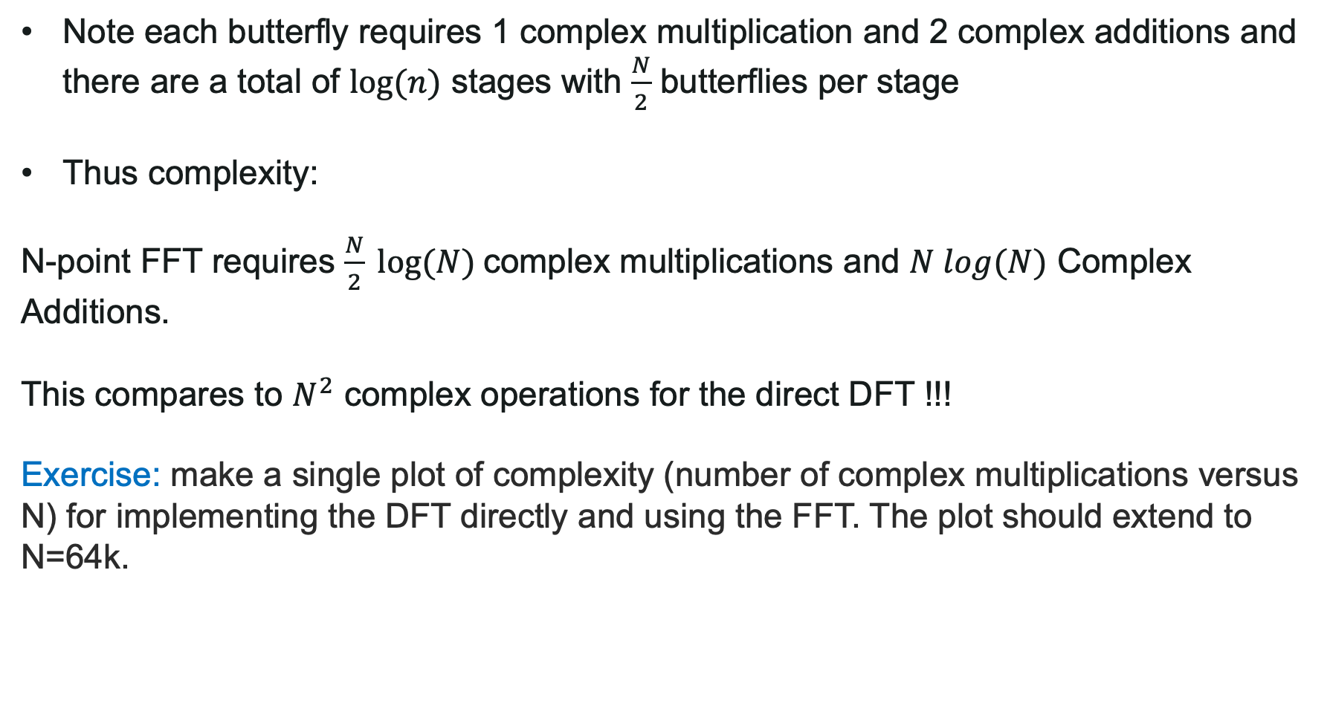
Radix 2 Decimation in time FFT method
Note each butterfly requires 1 complex multiplication and 2 complex additions and there are a total of $log⁡(n)$ stages with $\frac{N}{2}$ butterflies per stage
Thus complexity:
N-point FFT requires $\frac{N}{2} log⁡(N)$complex multiplications and $N log(N)$ Complex Additions.
This compares to $N^{2}$ complex operations for the direct DFT !!!
Exercise: make a single plot of complexity (number of complex multiplications versus N) for implementing the DFT directly and using the FFT. The plot should extend to N=64k.

Slide 40
Radix 2 Decimation in time FFT method
How do we start ? - BIT REVERSAL!
The decimation stage may be got by simply bit reversing the binary address of the data as:
The bit reversal process:
0) 000 → 000
1) 001 → 100
2) 010 → 010
3) 011 → 110
4) 100 → 001
5) 101 → 101
6) 110 → 011
7) 111 → 111
0
1
2
3
4
5
6
7
0
4
2
6
1
Exercise: In order to familiarize with this process do it for N=2, 4 and16
5
3
7

Slide 41
Notes on the FFT
FFT developed in 1966 by Cooley-Tukey revolutionised DSP.
The computational requirements of the FFT becomes NLog₂N operations
Real time DSP became possible. The main drivers in 60s and 70s were related to speech processing.
It is a fundamental block in most of digital technologies, with extensive use in telecommunications and multimedia (Audio, Image and Video, Wi-FI, OFDM) but also in sensing (Radar, Sonar, MRI Imaging), finance, etc…

Slide 42
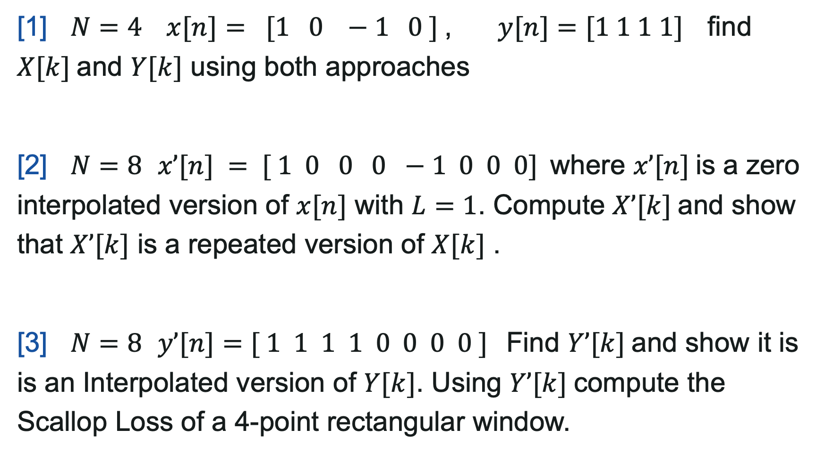
DFT Excercises
[1] $N=4 x[n]= [1 0 −1 0 ]$, $y[n]=[1 1 1 1]$find $X[k]$and $Y[k]$ using both approaches
[2] $N=8$ $x’[n] = [ 1 0 0 0 −1 0 0 0]$where $x’[n]$is a zero interpolated version of $x[n]$ with $L=1$. Compute $X’[k]$and show that $X’[k]$ is a repeated version of $X[k]$ .
[3] $N=8$ $y’[n]=[ 1 1 1 1 0 0 0 0 ]$Find $Y’[k]$and show it is is an Interpolated version of $Y[k]$. Using $Y’[k]$compute the Scallop Loss of a 4-point rectangular window.

Slide 43

Fast Algorithms – Convolution and correlation using the FFT
When the convolution or correlations within the segmentation algorithms are performed using computationally efficient algorithms such as the FFT then the resulting procedure represents a Fast Algorithm for implementing the convolution of correlation.
Thus, using the FFT, the Fast Algorithm for implementing the cyclic convolution and cyclic correlation are:
Fast Cyclic Convolution:
Fast Cyclic Correlation:
where $X[k]$ and $H[k]$ are the N-point Discrete Fourier Transforms of the N-length sequences $x[n]$ and $h[n]$.
Question: $x[n]=[1,0,0,1]$and $h[n]=[0.5,1,1,0.5]$compute the cyclic convolution and cyclic correlation between x[n] and h[n] using the direct approach and the fast algorithm.
Use Matlab for this problem.

Slide 44
Fast Algorithms – Convolution and correlation using the FFT
xn=[1 0 0 1];
hn=[0.5 1 1 0.5];
N=length(xn)+length(hn)-1;
xn2=[zeros(1,N-length(xn)) xn]; % prepend zeros
xnft=fft(xn,N); % append zeros to make length N
xn2ft=fft(xn2,N);
hnft=fft(hn,N); % append zeros to make length N
conv_xh=ifft(xnft.*hnft);
Rxh=fftshift(ifft(xn2ft.*conj(hnft)));
yconv=conv(xn,hn);
ycorr=xcorr(xn,hn);

Slide 45
Fast Algorithms – Convolution and correlation using the FFT
N | Direct Method N² | Fast Convolution 12Nlog₂(2N)+8N | Complexity ratio: fast/direct
8 | 64 | 448 | 7
16 | 256 | 1,088 | 4.25
32 | 1,024 | 2,560 | 2.5
64 | 4,096 | 5,888 | 1.4375
128 | 16,384 | 13,312 | 0.8125
256 | 65,536 | 29,696 | 0.4531
512 | 262,144 | 65,536 | 0.25
1024 | 1,048,576 | 143,360 | 0.1367
2048 | 4,194,304 | 311,296 | 0.0742

